Slide 1
U.S. Army PEO STRI
Logistics Management System
Braden Cariaga & Henry Thiel

Slide 2
Agenda
01
Project Overview
Brief overview of the project and its requirements
02
Epic Overview
Description of our implemented Agile epic and user stories
03
User Stories
Describe and demonstrate each user story for the epic
04
Testing Overview
Unit, system, and blind user study testing
05
Demo
System overview and functional demonstration

Slide 3
PEO STRI
Program Executive Office Simulation, Training, and Instrumentation
Logistics Management Software
PEO STRI manages training and simulation for the US Army
Want an enterprise application to improve process and project workflow:
Enable logisticians to populate status of requirements and sub-requirements
Route projects automatically to relevant users
Expose project status to outside parties
Implement “back-tracking” procedures
Simply processes

Slide 4
Epic Overview
Provide a mechanism for project administration.
1
As a logistician I want to create projects so I can deliver projects.
2
As a system administrator I want to edit projects so I can fix mistakes that were made when creating.
3
As a project manager I want to delete projects after completion so I can mark them as complete.

Slide 5
User Stories

Slide 6
User Story 1
As a logistician I want to create projects so I can process projects.
Task 1: User interface – Medium (6/10)
Task 3: Application Server – High (9/10)
On the project administration page, add a button titled “Create a Project”
On the click action of “Create a Project”, the user should be redirected to a “Create a Project” Page.
The Create a Project page needs to be created with a form featuring project information fields.
On the application server, a route needs to be created to receive the HTTP POST request from the client interface.
On the route, the server needs to:
Verify authenticity and permissions of the requestor.
On failure a response code of 401 is returned to the requestor.
Validate body of request.
On failure a response code of 400 is returned to the requestor.
Connect to the database and store project information in the projects document.
Issue a 201-response code.
Task 2: User Interface and Application Server Interaction – Medium (6/10)
On the submit button action of the user interface, the client needs to submit a POST HTTP request to the application server containing the form fields as the body.
Task 4: Database – High (8/10)
On the database, a Projects document needs to be created so that the projects can be stored upon request.

Slide 7
User Story 2
As a system administrator I want to edit projects so I can fix mistakes that were made when creating.
Task 1: User interface – Medium (6/10)
Task 3: Application Server – High (9/10)
On the project administration page, a product list should be shown. From that list, there should be a button titled “Edit Project”.
On the click action of the “Edit Project” button, the user should be redirected to a “Edit a Project” page, which is styled like the “Create a Project” page.
The page should pre-fill the form fields of the create a project.
On the application server, a route needs to be created to receive the HTTP PUT request from the client interface.
On the route, the server needs to:
Verify authenticity and permissions of the requestor.
On failure a response code of 401 is returned to the requestor.
Validate body of request.
On failure a response code of 400 is returned to the requestor.
Connect to the database and update the project information in the projects document.
Issue a 200-response code.
Task 2: User Interface and Application Server Interaction – Medium (6/10)
On the submit button action of the user interface, the client needs to submit a PUT HTTP request to the application server containing the form fields as the body.

Slide 8
User Story 3
As a project manager I want to archive projects after completion so I can mark them as complete.
Task 1: User interface – Medium (6/10)
On the project administration page, a product list should be shown. From that list, there should be a button titled “Delete Project”.
On the click action of the “Delete Project” button, the user should have a modal appear asking to confirm their action.
Task 3: Application Server – High (9/10)
On the application server, a route with a dynamic path for the _key of the project needs to be created to receive the HTTP DELETE request from the client interface.
On the route, the server needs to:
Verify authenticity and permissions of the requestor.
On failure a response code of 401 is returned to the requestor.
Validate the supplied _key from the route path.
On failure a response code of 400 is returned to the requestor.
Connect to the database and delete the project and its modules and tasks.
Issue a 200-response code.
Task 2: User Interface and Application Server Interaction – Medium (6/10)
Once the user confirms their action on the user interface, the client needs to submit a DELETE HTTP request to the application server with the _key of the project as path of the request URL.

Slide 9
Testing Overview

Slide 10
Backend Testing
Input Validation Unit Testing
Automated Blackbox System Testing
Store structure description data
Check elements of passed document match stored structure
Throw error if invalid structure is passed
Errors detectable during development
Send HTTP requests to the backend
Uses edge-case test data
Invalid documents are also tested
Reponses from the server are validated
Checks status code, headers, body type and body fields.

Slide 11

Frontend Testing (User Study)
Objective 1: Identify any faults or failures in the components and their integration with each other. (Unit Testing)
Objective 2: Identify shortcomings in the intuitiveness and usability of the application.
Testing Objectives
Objective 3: Identify faults in the design and styling of components.
Objective 4: Identify faults or failures in the integration of the client and server. (Integration Testing)

Slide 12
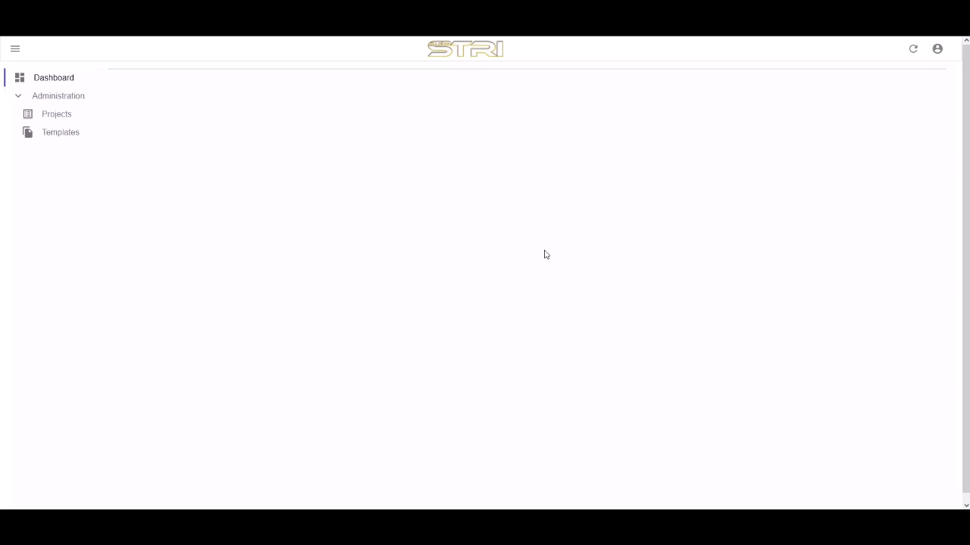
Demo

Slide 13
Questions?
Braden Cariaga
&
Henry Thiel

